Slide 1
LETTER WRITING
Formal AND INFORMAL

Slide 2
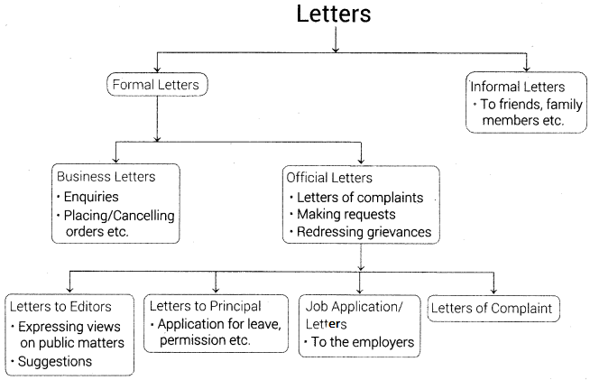
A letter is a written message that can be handwritten or printed on paper. It is usually sent to the recipient via mail or post in an envelope, although this is not a requirement as such. Any such message that is transferred via post is a letter, a written conversation between two parties.

Slide 3
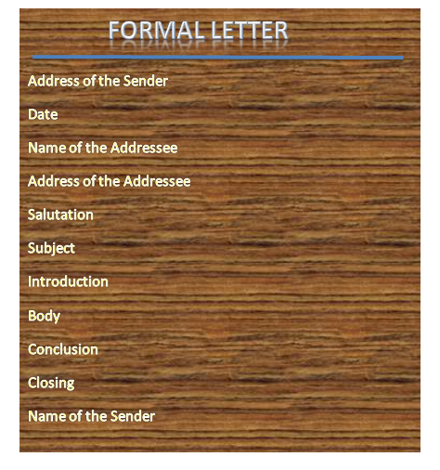
Writing a formal letter
To write a formal letter follow the below-given tips: Address or greet the concerned person properly like Dear Sir/Madam.
Always mention the subject of writing the letter.
Be concise in your letter.
Write the reason for writing the letter in the first paragraph itself.

Slide 4
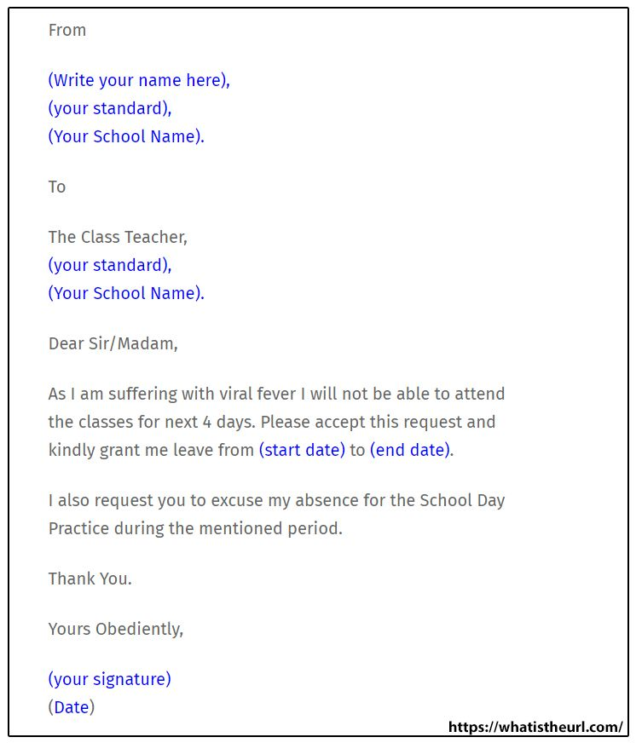

Slide 5
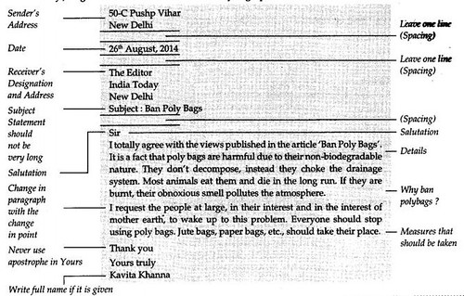

Slide 6
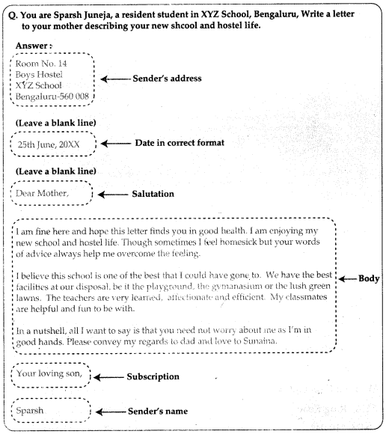
Informal Letter:
An informal letter is a non-official letter that we usually use to write to our friends, family or relatives. These letters are personal letters that are not used for official purposes. There could be many reasons for which we write these letters to our family and friends. For example, if we want to inform them about our achievement in school or college, then we write them a letter to spread our personal news.

Slide 7
What is an Informal Letter?
What is an Informal Letter - An informal letter, also referred to as a friendly letter, is a personal letter written to friends or relatives (Informal letter to a friend). It is written in a personal fashion. You can write it to anyone with whom you have a non-professional relationship, although this doesn't exclude business partners or workers whom you're friendly with either. There are fewer formatting rules for informal letters than there are for business or formal letters. The letter can be used for some reasons like conveying messages, news, giving advice, congratulate the recipient, request information, asking questions, etc.
It is a personal letter, written to whom you are familiar with, like friends, siblings, parents, or any other closed one. While writing an informal letter, one can afford to be friendly, and make use of personal or emotional tone

Slide 8
Difference between Formal letter and Informal letter
Formal Letter And Informal Letter - The formal letter is written for business or professional purposes with a specific objective in mind. It uses simple language, which is easy to read and interpret. On the contrary, informal letters are written to friends and relatives for personal communication and require a casual or emotional tone. The size of a formal letter should be concise; that does not include irrelevant matters. In contrast, the informal letter can be lengthier.
Formal letters are used for writing letters to business contacts, i.e. partners, suppliers, customers, clients, etc. , college or institute, employer, professionals, etc. As against this, we write informal letters to friends, relatives, acquaintances, etc.

Slide 9
Informal Letter Format
Informal Letter Format - There is no set format for an informal letters. But there is a general pattern, some conventions that people usually follow. We will be looking at this pattern and certain tips on how to write effective and attractive informal letters. These can act as guidelines when you are drafting a letter; they are not hard and fast rules. Let us begin
Informal Letter Format - Address
The first thing to write is your address, i.e. the address of the writer (basically, the sender’s address). We usually write the address on the left-hand side of the page at the very top. The address should be accurate and complete. Even when writing to close friends or relatives the address must be written, so they can reply back to the letter with ease. If the recipient of the letter is in another country, do not forget to write your country as well in the address.

Slide 10
Informal Letter Format - Date
Next just below the address we write the date. This allows the reader to have a reference as to when the informal letter was written. He can then relate better to the contents of the letter. The date, preferably, shold be in expanded form.
Informal Letter Format - Greeting
Now since you know the person you are writing to, the greeting can be informal as well. If it is a friend or someone close to your age you can greet them by their first name, like “Dear Alex”.
If you are writing to your relative like your mother/father/aunt/uncle etc, you may greet them as such, for example, “Dear Mom”. And if you are writing to an elder person, someone you respect greatly you can address them as Mr or Mrs. Like say for example you were writing a congratulatory letter to your teacher, it can be addressed as “Dear Mrs. Alex”.
Informal Letter Format - Introductory Paragraph
And now we begin writing the actual letter. The introductory paragraph sets the tone for the whole letter. You might begin by asking the recipient about their well being. Or you may say that you hope the letter finds them in good health and great spirits. The opening of informal letters should be casual and comforting. It must not be formal and direct as in business letters.

Slide 11
Body of the Letter
The letter overall should maintain a friendly tone. But you have to adjust the language and the wordings according to who you are writing to. With a friend, you can afford to be very casual and flippant even. But if you are writing to an elder relative, you must be extremely respectful and considerate. One way to determine the tonality of your letter is to remember how you talk to the person in a conversation. And then apply the same syntax and sentiments to the letter.
Informal Letter Format - Conclusion
In the conclusive paragraph sum up the reason for writing the letter, i.e. summarize the letter. Say a meaningful and affectionate goodbye to the reader. And do not forget to invite the reader to write back or reply to your letter. It shows an intention to keep the conversation going.

Slide 12
Signature
There is no one way to sign off informal letters. Since they do not follow a strict format, you may sign off as you please. Some commonly used phrases are
Lots of Love
Best,
Best Wishes,
Kind Regards,
Kindly,
Pick the one that best suits the occasion and then simply signs your name below the greeting.

Slide 13
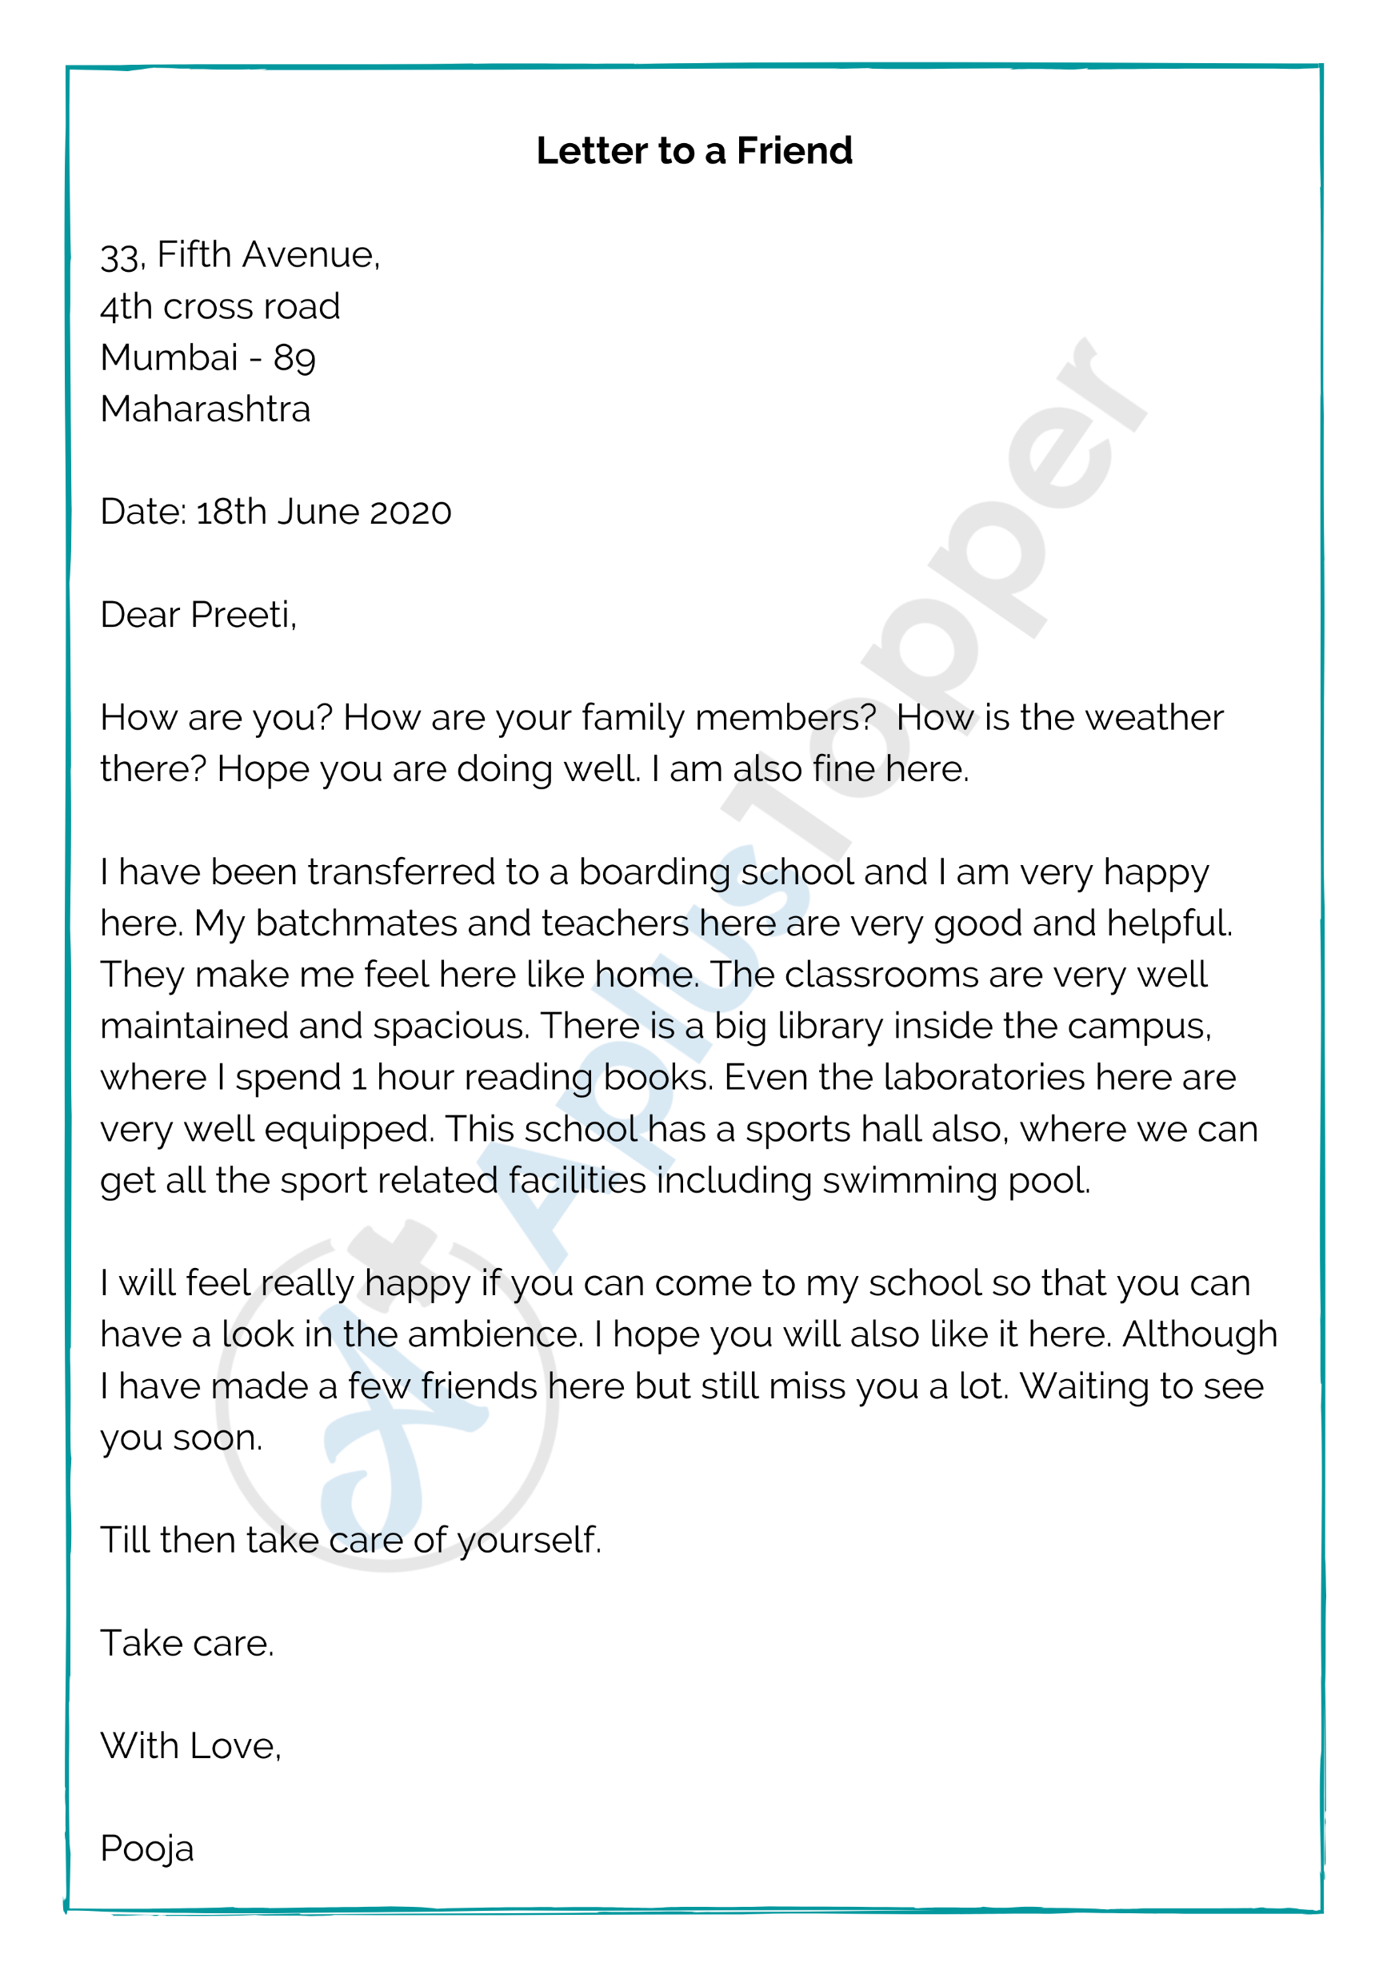
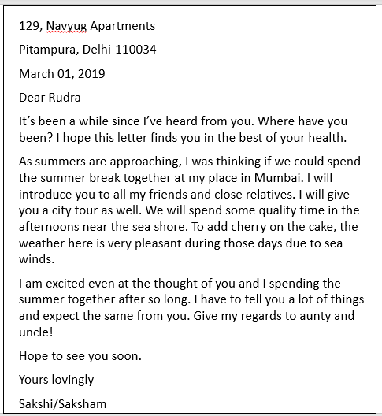

Slide 14
Tips for writing Informal Letter
Make sure you double-check for grammatical accuracy and spellings. They carry marks.
Leave an adequate number of lines between paragraphs to make it look neat.
Underlining the main points is very important. But it is advised to do it after finishing your exam. Use a pencil and scale for underlining.
The presentation is very important.
Read a lot of letters to get an idea.
Informal Letter Topics
Below is a list of a few important topics-
Inviting a friend
Advising a friend
Apologizing to a friend
Thanking a friend for spending the holiday together
Reminding a friend
Congratulating a friend
Requesting for help
Admitting a mistake

